Slide 1

COS 214 Project
sudo-apt-get-marks

Slide 2
sudo-apt-get-marks members
u22497082 - Ethan Vletter
u22652974 - Carinda Smith
u23632730 - Janri du Toit
u23577674 - Ethan Wilke
u23656175 - James Neale
u23708833 - Megan Pretorius
u23590883 - Marco Paximadis

Slide 3
Introduction

Slide 4
Final class diagram

Slide 5

City Management:
Create and manage different types of buildings.

Slide 6
Buildings
Add class diagram

Slide 7
Buildings
Explain pattern and attributes and methods

Slide 8

City Management:
Manage Utilities
Powerplants : generate electricity to supply to city.
Functional and Non-functional
Water Supply : ensure steady distribution of water.
Functional and Non-functional
Waste Management : handle waste removal and recycling.
Functional and Non-functional

Slide 9
Utilities
Add class diagram

Slide 10
Utilities
Explain pattern , attributes and methods

Slide 11
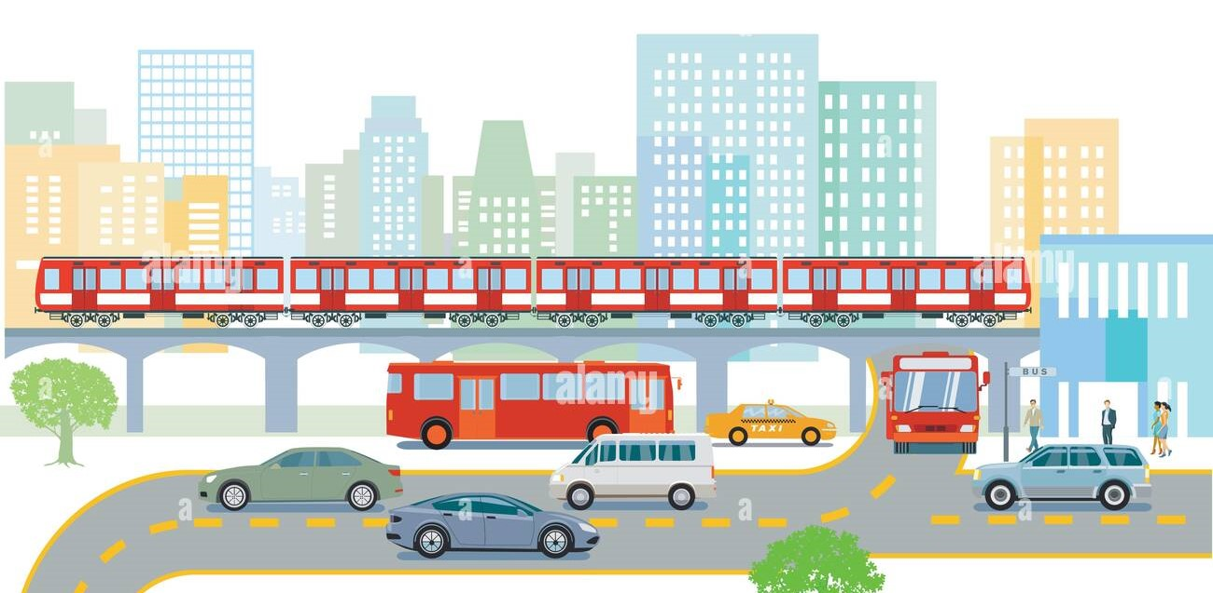
City Management:
Handle Transportation system.
Roads: Basic infrastructure for public transport movement.
Public Transit: Buses to transport citizens to and from place of employment.
Commercial busses transport Commercial Workers to/from
Residence: House to/from Workplace: shop/mall/office on a Commercial road
Government busses transport Government Workers to/from Residence: Mansion to/from Workplace: school/hospital/government on a Government road
Industrial busses transport Industrial Workers to/from Residence: Apartment to/from Workplace: warehouse/plant/factory on an Industrial road
Trains: Transport materials on railways

Slide 12
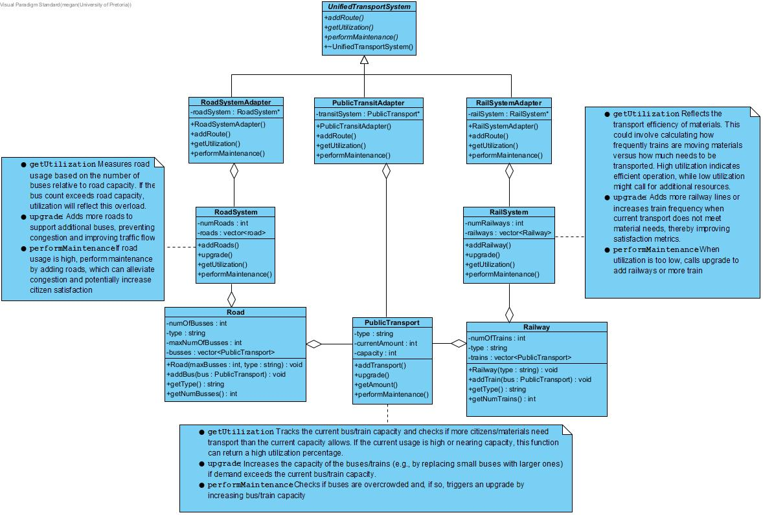
Transportation

Slide 13
Transportation
Explain pattern and attributes and methods

Slide 14
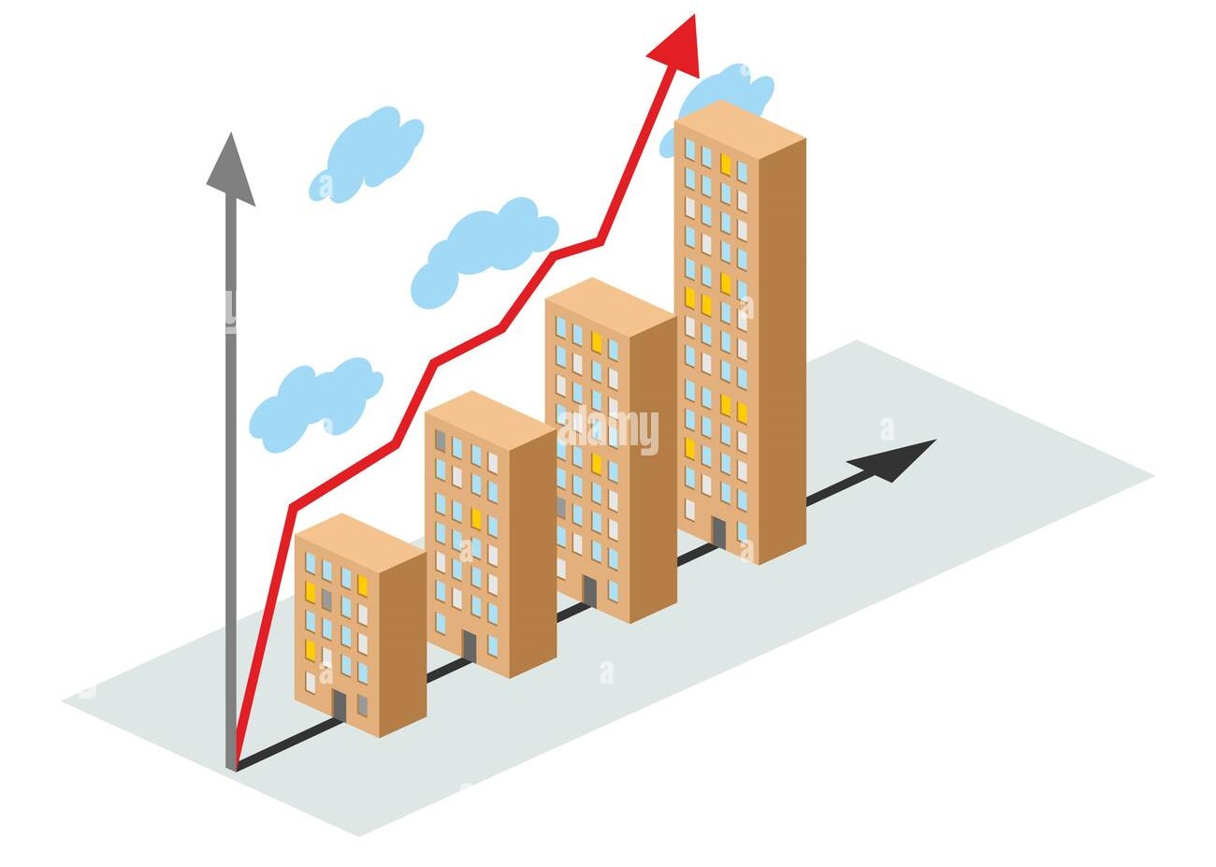
City Management:
City creation and growth

Slide 15
City Management:
Add class diagram

Slide 16
City Management:
Explain pattern , attributes and methods

Slide 17

Resources:
Explain resources

Slide 18
Resources:
Add class diagram

Slide 19
Resources:
Explain pattern , attributes and methods

Slide 20

Taxes
Explain taxes

Slide 21
Taxes
Add class diagram

Slide 22
Taxes
Explain pattern , attributes and methods

Slide 23

Government
Explain government

Slide 24
Government
Add class diagram

Slide 25
Government
Explain pattern , attributes and methods

